Slide 2
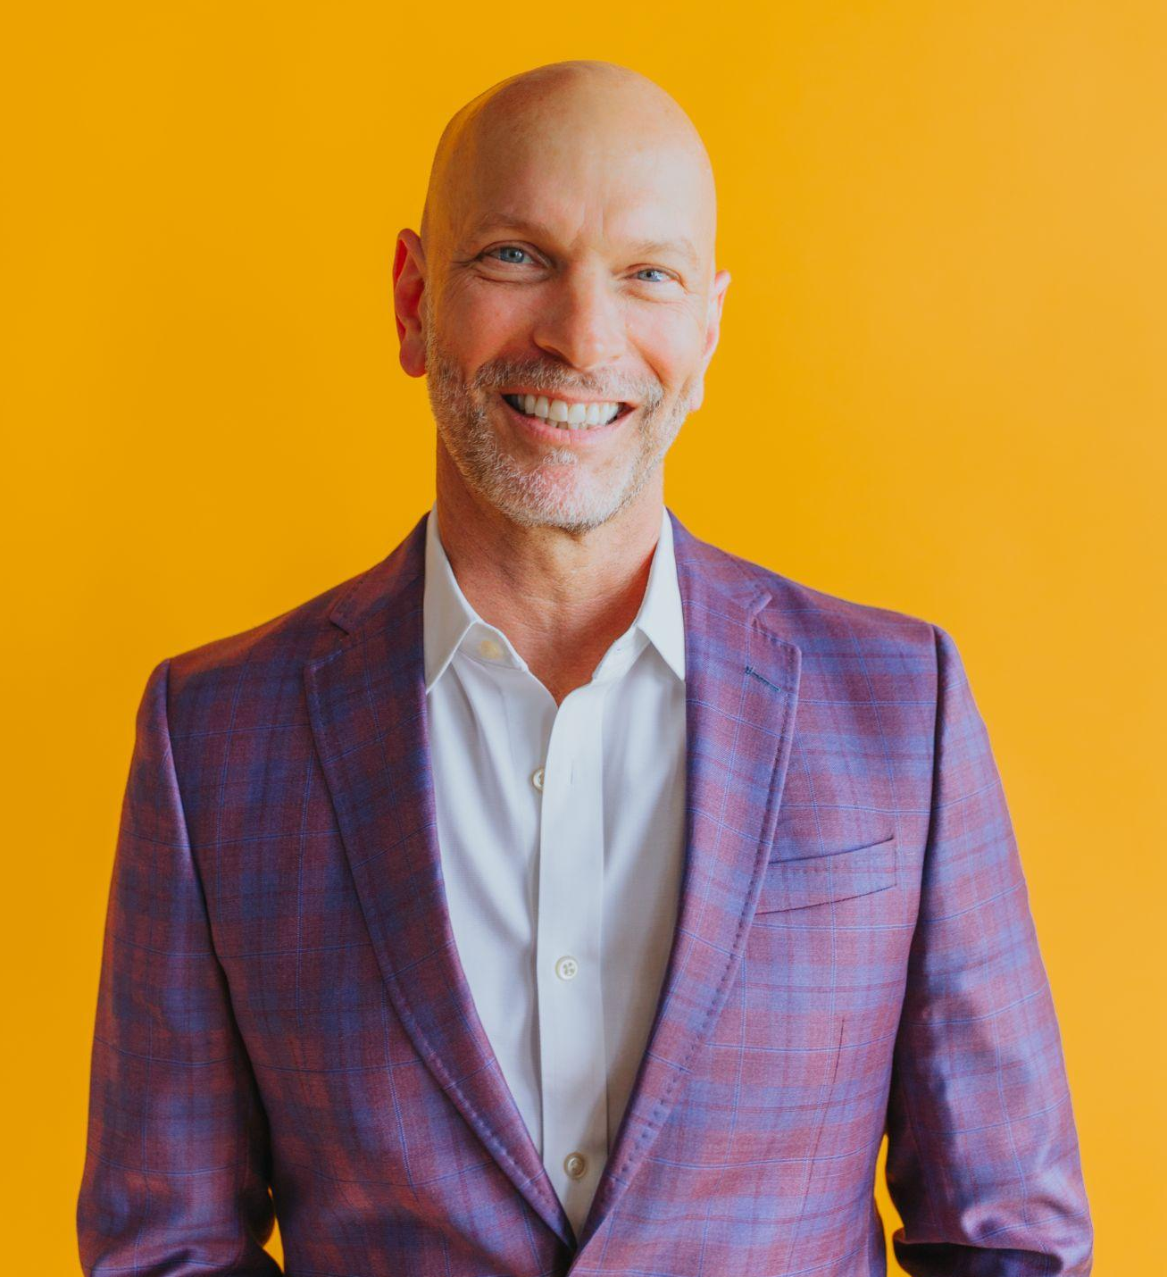
EXPERIENCE FRESH
With You Today
STEVE HOWELL
Chief Revenue Officer/Partner
Former VP of Marketing at Aline
20 years agency experience
Emphasis in digital/AI and emerging tech
Across verticals + senior living focus
Aligning brand + marketing strategy with business objectives
Notes:
STEVE HOWELL
CRO
Former VP of Marketing at Aline
20 years agency experience
Emphasis in digital/AI and emerging applications

Slide 3
We connect people to brands that make life better.

Slide 4
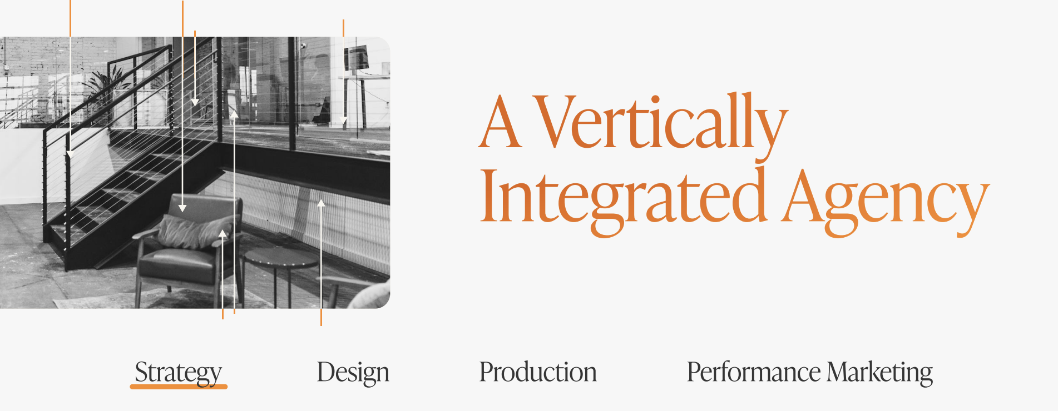

Slide 5
Topics
SEO considerations (before the first click)
Paid media considerations (the click)
Building trust (after the click)
Lead measure reporting (which clicks matter?)
AI for lead intelligence (beyond clicks)

Slide 6
SEO CONSIDERATIONS

Slide 8
Two Main Types
Onsite
Website Content, Keywords, Technical, UI/UX
Offsite
Social, Backlinks, Reviews

Slide 9
Onsite - Content
Relevance: Ensure content is relevant to keywords and meets the needs of your audience
Depth and Value: Provide in-depth information answering their queries comprehensively

Slide 10
Onsite - Keyword Optimization
Research: Identify the terms and phrases your target audience is searching for
Placement: Use strategically in titles, headers, meta descriptions, and throughout the content
Long-Tail Keywords: Incorporate these to capture more specific search queries
Notes:
Senior living near me
Keywords vs search terms: Senior living or assisted living vs nursing home

Slide 11
Onsite - Long-Tail Examples
"Best assisted living facilities with memory care in Blue Springs, MO" (location)
"Senior living communities with pet-friendly policies in Texas" (amenities)
"Senior living options for veterans in California" (specific needs)
Notes:
"Medicaid-accepted senior living facilities in Pennsylvania" (financial)
Niche Targeting: They allow you to target specific niches within the senior living market, reducing the number of competitors and increasing visibility among a targeted audience.
Lower competition and lower search volume
Higher intent
More specific search results/accurate/lower bounce rates/virtuous cycle
VOICE SEARCH!

Slide 12
Onsite - Technical SEO
Indexing and Crawling: Use an XML sitemap and robots.txt file to ensure engines can crawl site
Mobile-Friendliness: Optimize your site for mobile devices since MOST searches conducted on mobile
Site Speed: Ensure your website loads quickly, as page speed is a ranking factor

Slide 13
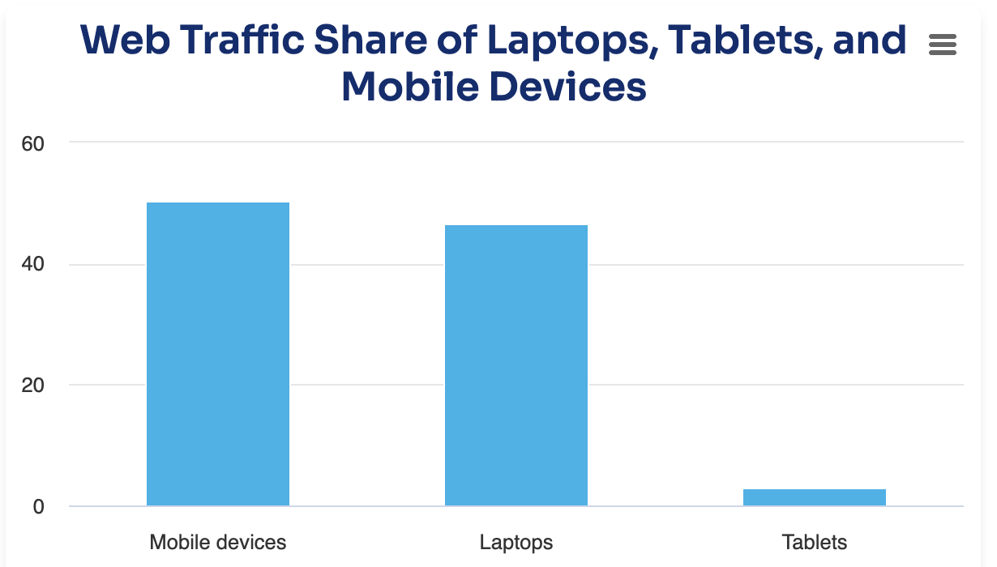

Slide 14
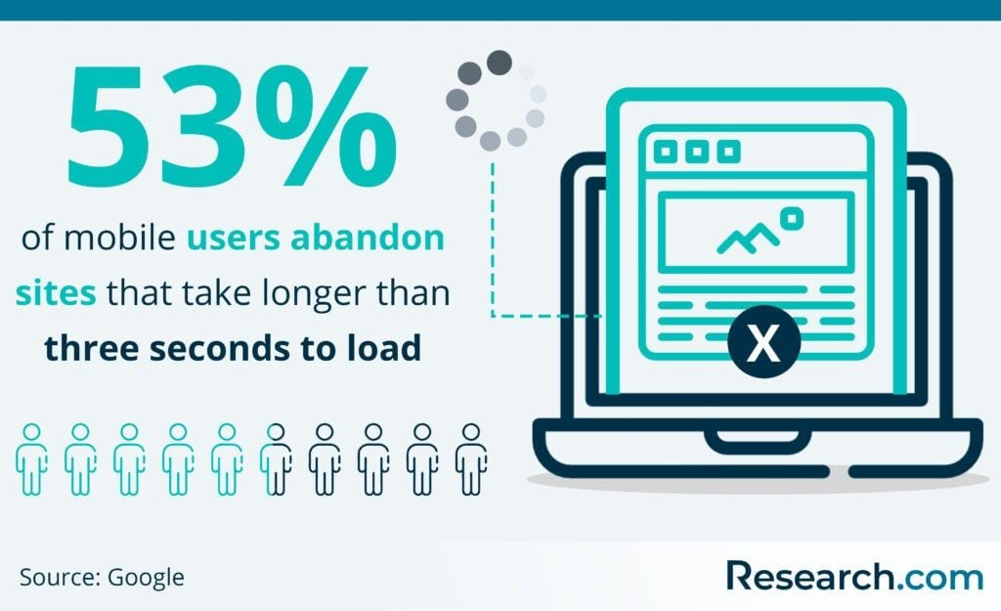

Slide 15
Onsite - UI/UX
Ease of Navigation: Ensure your website is easy to navigate, with a clear structure and intuitive layout
Engagement: Encourage user engagement through interactive elements
Bounce Rate: Reduce rates by providing engaging and relevant content that meets user intent

Slide 16
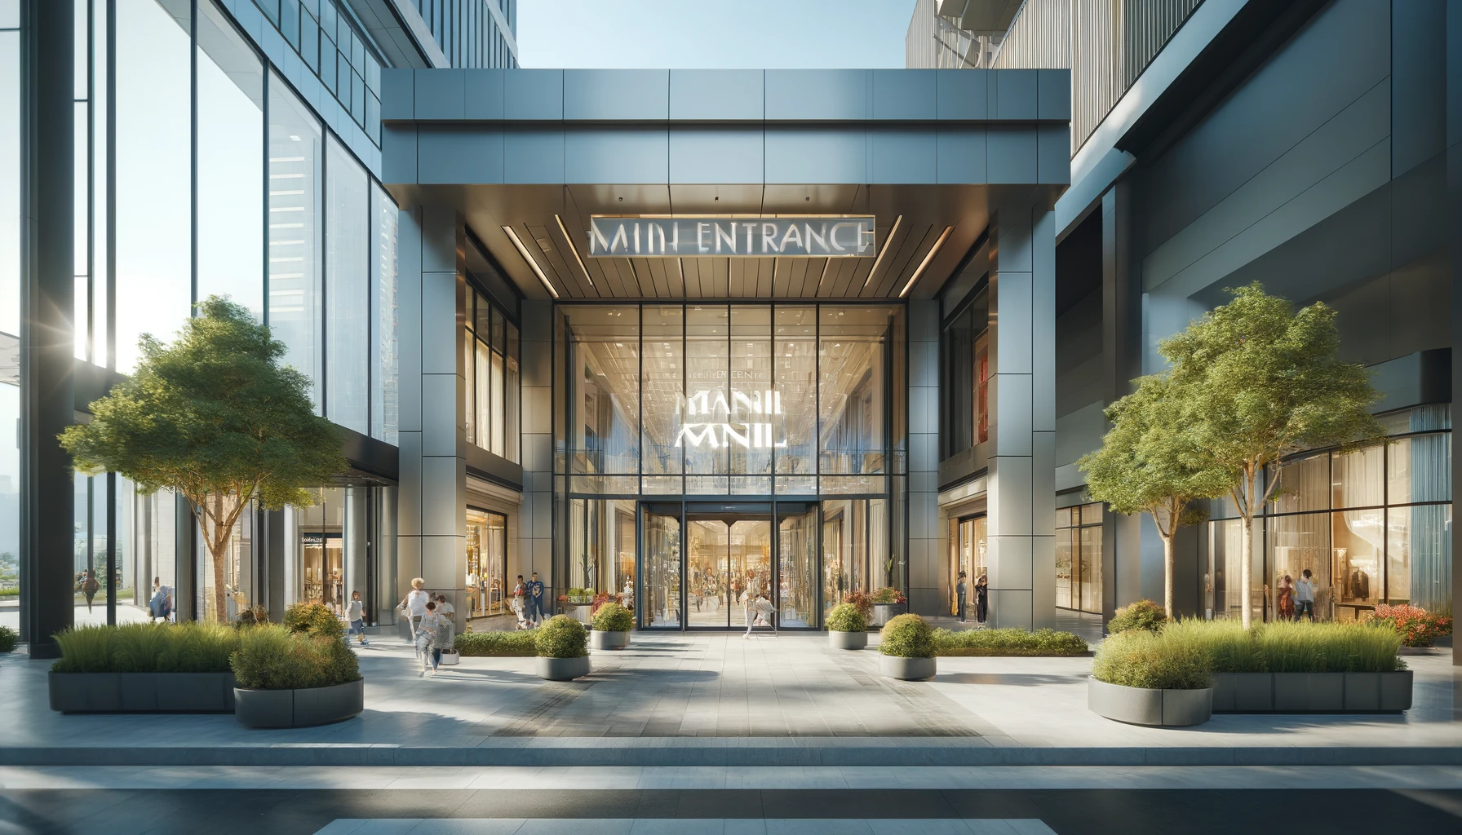

Slide 18
https://www.cedarhurstliving.com/cedarhurst-tesson-heights-mo

Slide 19
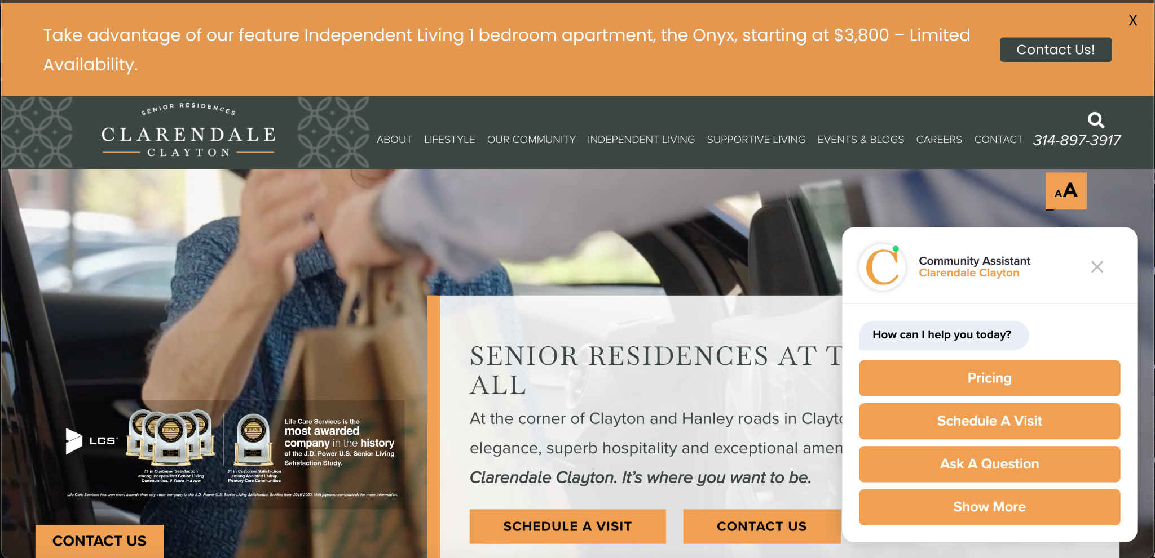
https://www.clarendaleclayton.com/

Slide 20
Offsite - Social Signals
Engagement: Actively engage audiences since likes, shares, comments, and overall engagement indirectly impacts SEO by driving traffic to your site
Content Distribution: Use social media to distribute your content, increasing its reach and the likelihood of earning backlinks
Notes:
Also: Brand Awareness: Building a strong presence on social media can enhance brand awareness and authority, which can lead to more search engine visibility and trust.

Slide 21
Offsite - Backlinks
Quality over Quantity: High-quality backlinks from reputable, authoritative websites
Natural Link Building: Create compelling, shareable content
Diverse Sources: Diversity helps in showing search engines that your website has a broad appeal

Slide 22
Offsite - Reviews
Reviews and Ratings: Encourage positive reviews on Google My Business, Yelp
Mentions and Citations: Consistent NAP citations (Name, Address, Phone Number)
Respond to Feedback: Monitor and respond to online feedback and reviews
Notes:
\

Slide 23
Cafe Example
Ginger and turmeric pulp used to make chai
Partners with coffee roaster in Colombia for an all women coffee farmer for the pour over program
Makes all sauces and dressings by hand and scratch (caramel, chai syrup, lavender, etc)
Makes vegan butter, mayo, jams
Croissant dough imported (France)
Composts all food waste, 5-Star rating with green dining alliance, the authority for sustainability in restaurants in StL region
Juices all cold pressed in house
Uses local dairy farms. They have two cows, Fiddle and Fern
Pays employees to volunteer a couple times a year

Slide 24
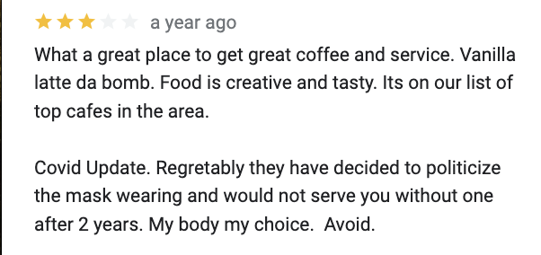
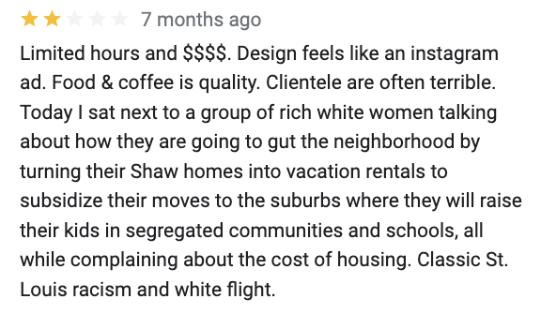
Offsite - Reviews

Slide 25
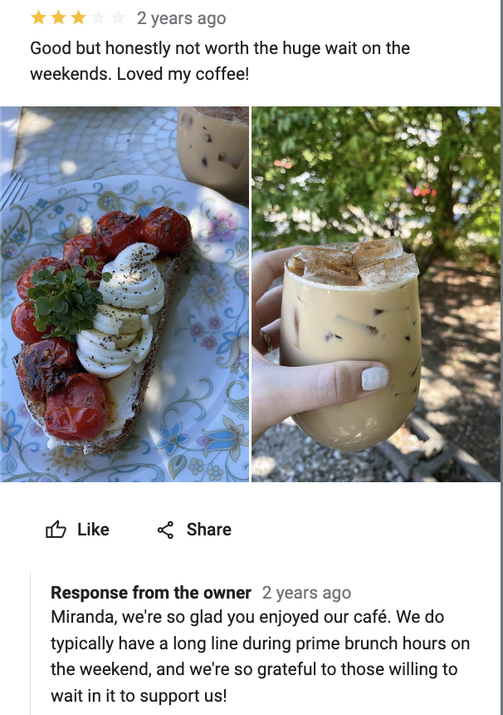
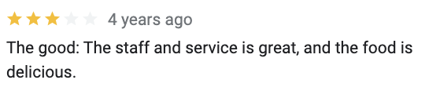
Offsite - Reviews

Slide 26
PAID MEDIA CONSIDERATIONS
Notes:
When planning a paid media strategy, there are several key considerations to ensure effective campaigns and a good return on investment (ROI).
The more specific your targeting, the better you can tailor your ads to meet the needs and preferences of your potential customers.

Slide 27
Target Audiences
Audience Segmentation: Target audience based on demographics, interests, behaviors, and location
Custom and Lookalike Audiences: Facebook’s Custom Audiences or Google’s Customer Match to target users who already interacted with brand - past customers or website visitors

Slide 28
Target Audiences
Compelling Visuals and Copy: Create high-quality, eye-catching visuals and compelling ad copy, communicate the value proposition w/CTA
Ad Formats and Variations: Experiment w/different ad formats (e.g., video, carousel, single image) and multiple variations to see which performs best

Slide 29
A/B Example
Ad A Copy: "Explore our welcoming senior living community. Schedule a tour today!"
Ad B Copy: "Discover a place where your loved ones can thrive. Our senior living community offers excellent care, vibrant social activities, and beautiful living spaces. Schedule a tour today!"

Slide 30
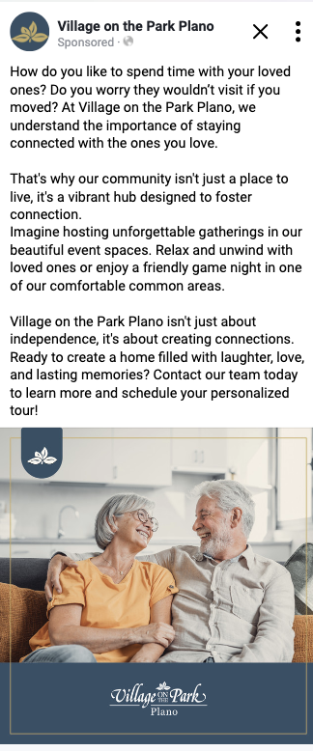
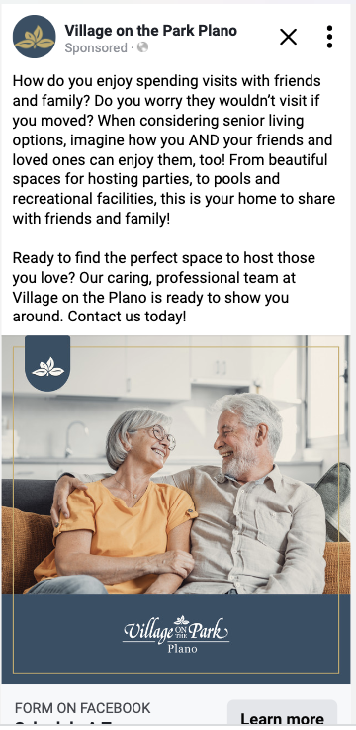
A/B Example

Slide 31
Targeted Ad Campaign
Attribution
Person clicks on Google Ad
Google Ads
Google Ads
Trains itself to find more of what you want.
Sends click IDs
CRM/MAP
Website
Sends offline events back to Google Ads
Visitor takes action on website (conversion)
CRM/MAP
Website
Visitor becomes a lead, takes tour, etc.
Sends click IDs to CRM/MAP along with lead info
Notes:
Mall reference for conversions
Target campaigns to meet prospects where they are
Know the value of a conversion
Connect clicks to offline conversions
Gather click identifiers (e.g., GCLIDs)
Append CRM data and send it back to Google Ads
Help algorithms understand which clicks led to conversions (and which did not)

Slide 32
Building Trust
Notes:
\

Slide 33
Build Trust through Empathic Connections
Notes:
founded in Boston in the 1800’s, built on quality and luxury experience
BUT, what they do uniquely – they put a place a price tag on empathy
From Dishwasher to GM – every employee is empowered toward empathy

Slide 34
Build Trust through Empathic Connections
“...(authorized) to spend up to $2,000 per day, per guest, without seeking approval from their superiors, to resolve any guest issues or complaints.”
Notes:
I heard Horst Schulze back in 2018 – and at that time in the companies history NO employee had ever spent the allotment – BUT, the notion that they can greet any situation with empathy has created a bond of trust between guests and resident and the brand.
Is it their marketing strategy? No. They deploy a content forward marketing strategy
Sales strategy? No. And not knowing their sales strategy fully i’m sure it deploys a mixture of affiliates, paid search/ social, and retargeting
Is it core to their brand? Yes – they platform ALL of their staff to be brand ambassadors – to the tune of $2,000/ per guest per day without any approval
To build trust
through empathic connection the following have to exists…

Slide 35
Build Trust through Empathic Connections
Notes:
For the CFOs… Ritz Carloton (owned by Mariott) would be bankrupt on the 14th day
Current Valuation: $1.1bn
119 Locations
40,000 employees
$80,000,000 in daily spending authority

Slide 36
Prospect-Centered vs Product-Centered
Brand Anthem Video
Notes:
This video lives on the main page of Friendship Village’s website and will be viewed many thousands of time during its useful life.
Four Themes (all prospect-centered, not property focused)
Actively
Courageously
Spiritually (belonging)
Safely
Key Quotes
“Not a Senior Living Community, but a Living Community”
Script NEVER mentions an amenity
“It takes courage to move.”
That last statement, “it takes courage to move” is just the beginning of building trust.

Slide 38
Content for Readiness
Stage: Denial
Topic: Home (also food, routines, interests)
Content Focused On:
Tell me about your home. How long have you been there?
What do you enjoy most about your home?
It sounds like your home is wonderful. Why would you even consider ever moving?

Slide 39
Content for Readiness
Email Content:
Hi [First Name],
We all have those little nooks in our home that hold special memories. Whether it's a sunlit spot on the sofa or the kitchen table that's seen a thousand meals and conversations - every space tells a story.
Thinking about moving can feel like a big leap; we understand the comfort home brings. We love hearing the stories of what makes homes like yours so special. And we’d love to show you around some of the beautiful spaces our residents are proud to call home here at [Community Name].
If you’re interested, let us know and we’ll find a time for you to visit.

Slide 40
Content for Readiness
Stage: Planning
Topic: Move Planning (also downsizing, isolation)
Content Focused On:
When was the last time you made a big change? What was that like?
When is the best time to move? Why then?
What concerns you most about moving?

Slide 41
Content for Readiness
Email Content:
Hi [First Name],
Change can be exciting, but even good changes need a bit of planning. That's especially true for a move. If a move to a senior living community is on your radar, let's first consider some logistics.
Here are a few tips to get started:
Be patient with yourself: Big decisions take time. Don't feel pressured to have everything figured out right away.
Start a wish list: Jot down what's most important to you in your ideal living space and community. This will help guide your search.
Visit communities in person: There's no substitute for experiencing a senior living community firsthand. Schedule a tour at [community name]!
This is just the beginning! A thoughtful approach will make all the difference. Let's create your perfect plan - connect with our friendly team to get started.

Slide 42
LEAD MEASURE REPORTING
Notes:
Lead measures in marketing reporting are predictive indicators that can help you gauge the future success of your marketing efforts. Unlike lag measures, which reflect past performance, lead measures can be influenced and acted upon to drive desired outcomes. Here are some examples of lead measures in marketing reporting:

Slide 43
Influenceable
+
Predictive

Slide 44
Lead Measures
Website Traffic - Page views, unique visitors, session duration
Engagement - CTR, bounce, SM engagement
Emails - Open rates, CTR, unsubscribes
Leads - Form submissions, MQLs, SQLs, Demo or tour requests

Slide 45
AI in LEAD INTELLIGENCE

Slide 46
What does AI do?
Mimics Human Intelligence: By learning from data, recognizing patterns, and making predictions
Automates Tasks: Complex and repetitive tasks such as customer service, data analysis, and manufacturing, enhancing efficiency and productivity
Continuously Improves: Through techniques like machine learning (e.g., spam filter)

Slide 47
AI in Lead Intelligence

Slide 48
AI in Lead Intelligence

Slide 49
AI in Lead Intelligence

Slide 50
AI in Lead Intelligence

Slide 51
AI in Lead Intelligence
Natural Language Processing: A chatbot detects your question from similar words/phrases (e.g., “show plans” becomes “Do you want to see floor plans?”)
Knowledge Base: Library or db of retrievable information
Retrieval-Augmented Generation or RAG: Retrieves relevant articles from a database to “generate” answers

Slide 52
AI in Lead Intelligence
Advertising: Generate ad creative and copy, optimize ad budgets, and predict campaign performance
Chatbots: Answer questions, nurture and schedule leads
Email marketing: Personalize campaigns by using user behavior data to generate emails (e.g., drip by stage)
PPC campaigns: Improve bidding, targeting, ad creation, scheduling, placement, and fraud detection

Slide 53
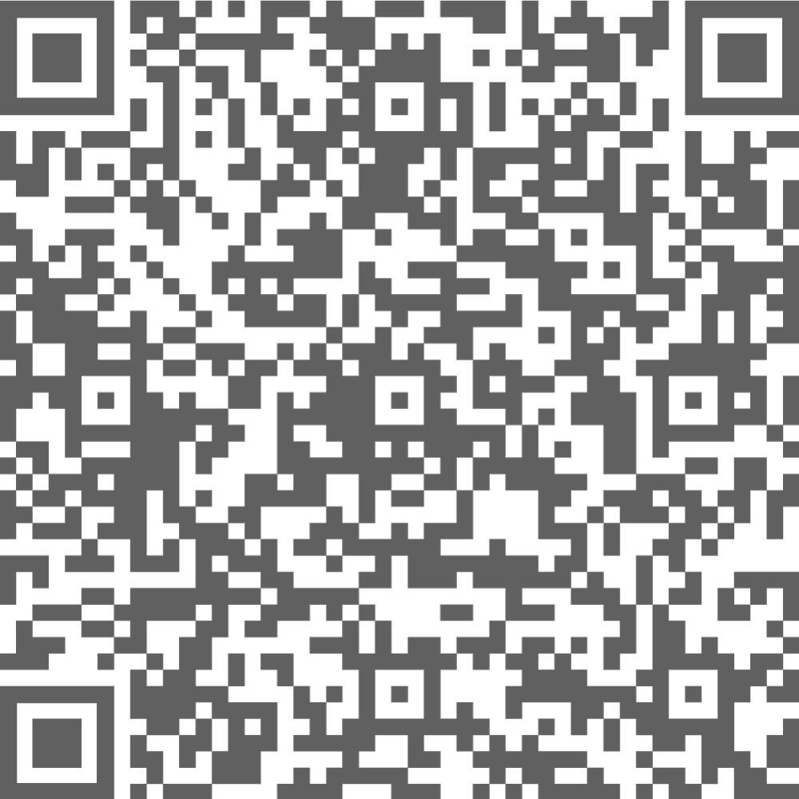
Get to know us…

Slide 54
AI in Lead Intelligence
Resources
Yext
SEMRush
Ahrefs
SEO Moz
Google’s PageSpeed Insights
Chrome’s Lighthouse

